Slide 1
Welcome to Reception Curriculum Afternoon
Wren Class

Slide 2
Little things to reassure you!
Remember we are there to help and look after them.
If children have come in unsettled/upset we will try at some point throughout the day to give you a call to let you know how they are.
Please feel free to phone the school to ask Mrs Ellis how they have settled if you are worried.
Toilet concerns, little accidents, spare underwear.
Tiredness.
Have they eaten enough at lunch time? No news is good news.
Bump at school.

Slide 3
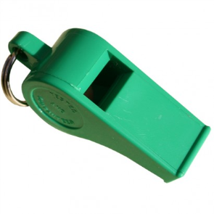
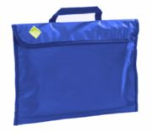
Little things to help!
Car Parking/ drop off system
Morning drop-off between 8.30am-8.45am
Coats and zips
Practise dressing and undressing
Book bags everyday please (with reading record and reading book)
IMPORTANT: please inform us if your child is going home with somebody else at the end of the day

Slide 4
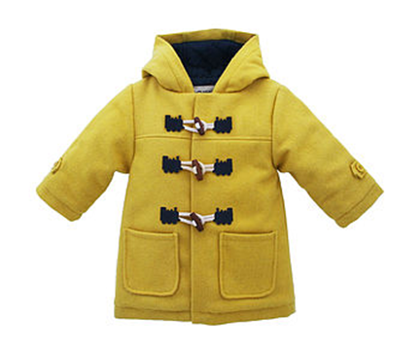
Little Reminders!
Please can your child have a water bottle to keep in the classroom.
Please can your child bring a coat into school everyday.
Please try and speak with us after school with any queries.
Please do not put water bottles in book bags.
Please name everything.
Show and tell is on a Tuesday.
PE is on a Tuesday & Friday – children come to
school ready in their PE kit.
Eye sight and hearing.
Medication.

Slide 5
Home Learning
Sharing/ Reading a book – 10 mins daily.
Phonics Bug interactive phonics games and e-books.
Mathseeds / Mathletics interactive on-line maths games.
Phonics Flashcards – Phase 2 and Phase 3 sounds.
Keywords– ongoing throughout year.
Blue keyword folder – Summer term.
Short and sweet!

Slide 6
Reception Baseline Assessment
The government have introduced a new baseline assessment for all reception children this year.
It is a short, interactive and practical assessment of your child’s early literacy, communication, language and mathematical skills.
The purpose of the RBA is to create a starting point to measure the progress schools make with their pupils.
It provides a snapshot of where your child is when they enter reception, so they can be supported in the most appropriate way.

Slide 7
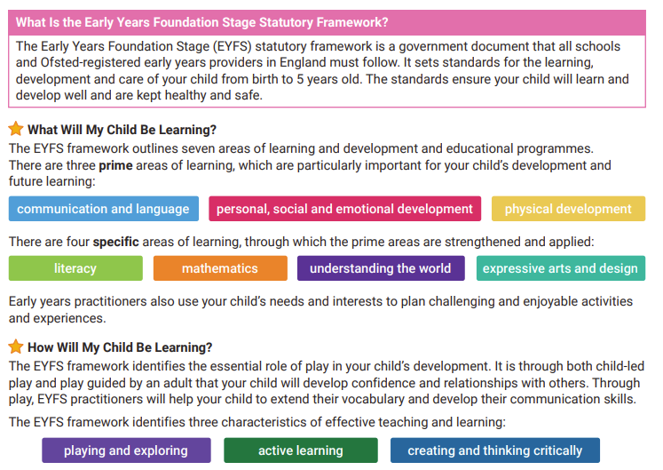
EYFS Curriculum 2021

Slide 8
Sounds
We use a phonics programme called Phonics Bug from Active Learn.
In addition, we have found that using an action and song to go with each letter sound, helps children to remember it.
We teach the letter sound and letter name – please note the difference. The focus initially is on the letter sound.
Games to play in the car:
batting words e.g. ‘how many words begin with ‘s’?
I SPY with my little ……. a, g, t.

Slide 9
Learning Sounds
Children will start to learn sounds very quickly in reception; normally 4 sounds a week.
Keywords will also be sent home to learn.
Writing - encourage your child to sound-out what they want to spell.
We want them to have a go by themselves and encourage independent work.
Spelling does not need be correct at this stage– encourage them to use their phonic knowledge and praise words which are phonetically plausible.
When does this change?
Keywords are used all the time.
Gradually children begin to recognise and write these words

Slide 10
Reading
Demonstrate reading.
Share reading books with them – continue to read to them as often as you can.
Different types of books: fiction / non-fiction.
Picture books – the book doesn’t have to have any words. Look at pictures in detail and encourage your child to talk about what they can see and what might be happening in the story.
Pictures can be used to help children to decode what a word might be or what is happening in the story, so please don’t cover up the pictures.
Reading skills: Comprehension and prediction.
IMPORTANT: You don’t have to read the whole book in one go or read every night.
Play games, e.g. look at different letters.
Develop a routine!

Slide 11
Reading and Writing
Reading and Writing are interlinked.
Reading helps sounds in writing.
Sound Sheet – Cursive writing.
Children can practise writing their own name cursively.
Lined Paper/pencil – practise writing and forming letters correctly.

Slide 12
Maths
Remember – numbers are all around us.
Can they recognise their numbers?
Counting forwards and backwards.
Counting – make sure they physically move object.
Practise writing numbers.
Ordering numbers – play what number comes next.

Slide 13
Keeping you informed!
Throughout the year we will keep you informed of how your child is progressing.
Within the year we will hold 2 parent consultation evenings (possibly offering virtual or in-person meetings).
Please do not hesitate to come and see us if there is anything you wish to discuss.

Slide 14
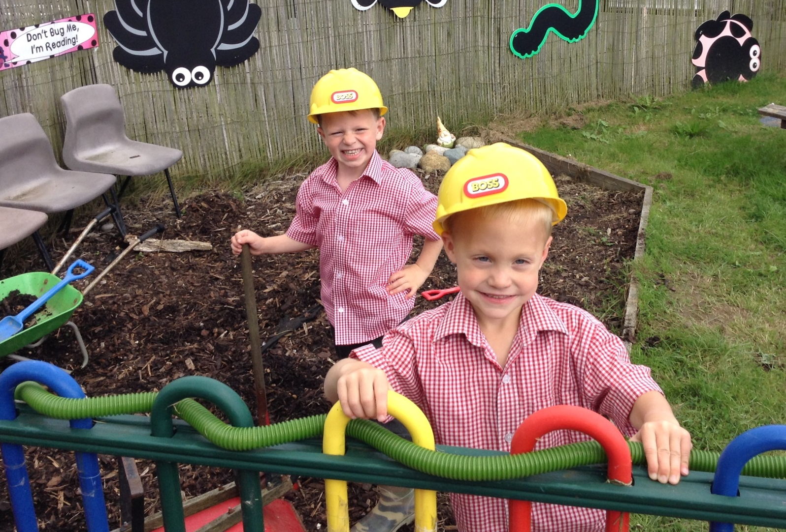
Time to get messy!!

Slide 15
Thank you!

